Slide 1
Gantt Chart
9/26/2018

Slide 2
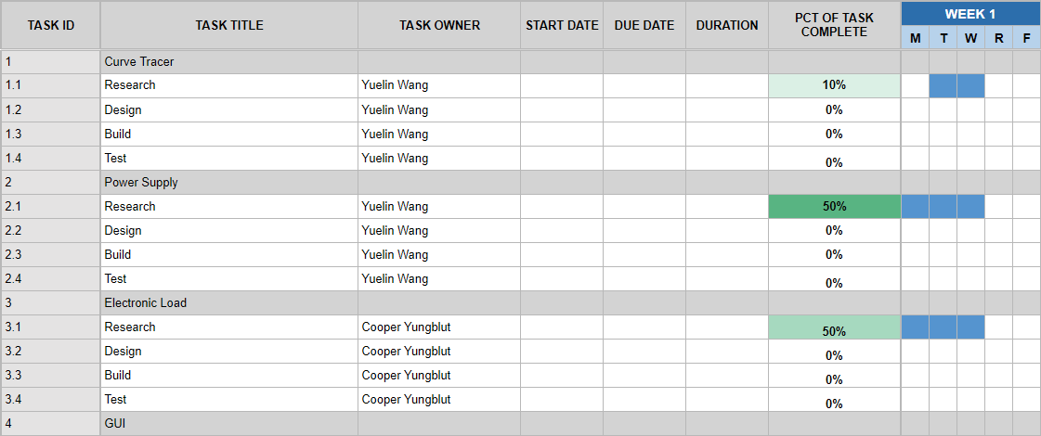

Slide 3
